Slide 1
TechCircle Battery DPP data + DPP system Architectural Guardrails JEDI Jena Digital Innovation Hub 13.02.2025

Slide 2
Legend
Mandatory
CLOSE
Optional
<Actor> Machine/plant
<Actor> Asset manager
<Actor> Manufacturer
1
<action, operation>
2
<action, operation>
4
<Optional operation>
3
<action, operation>
Systems (i.e. ERP, MES etc.)

Slide 3
<# Your Use Case>
Challenge: <Describe the intention of your use case.>
Description: <Describe details of previous defined interaction between or within an actor you’ve placed in the swimlane: What is important? What is the outcome/ interface/ data details etc. operations/ actions are based on or make use of.>
Roles/personas: <Stakeholders involved within your use case: Actors of your swim lane, reduced to people.>
Target group: <Stakeholders interested in your use case: Who you write this for?>
Benefits & value: <Describe the value of the use case.>
Supporting content: <Relate to other use cases, especially when: 1) Another use case is required prior to your use case. 2) Your use case is the foundation for other use cases.

Slide 4
Process House Kit: Architectural Guardrails
A sequence diagram: Technology specific view
<component>
<component>
<component>
<Actor> Asset manager

Slide 5
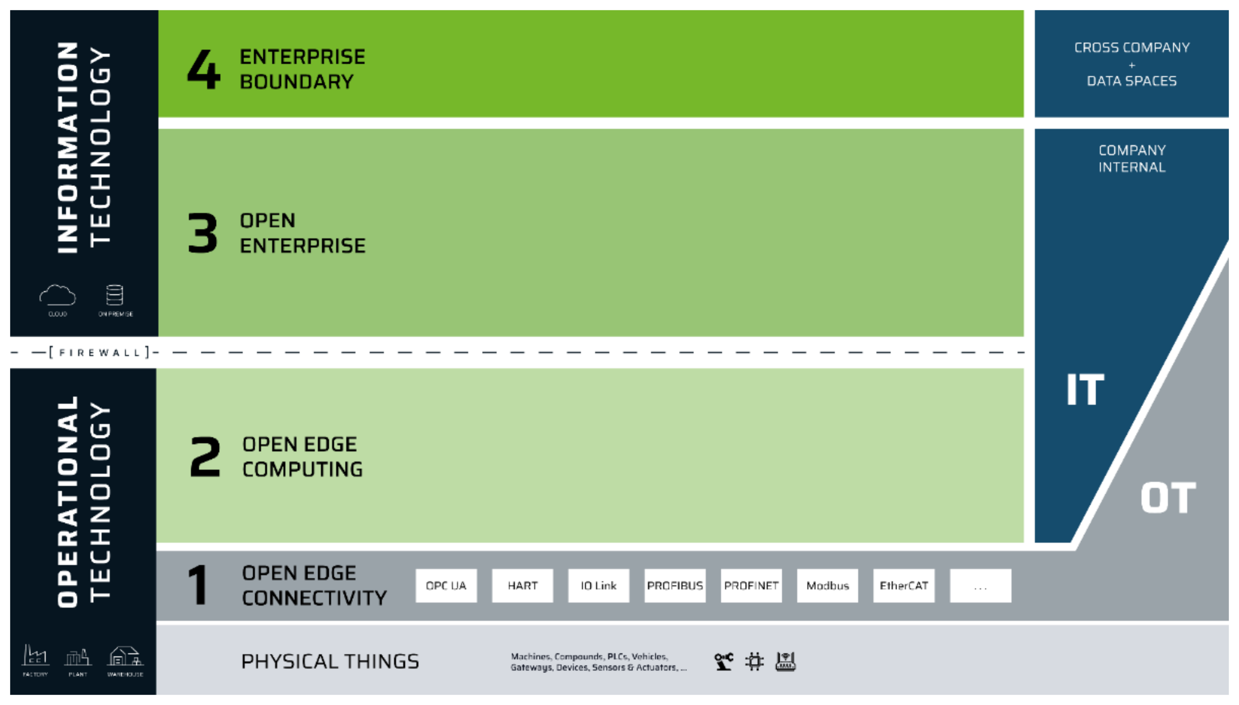
Process House Kit: Architectural Guardrails
Structural diagram: Component diagram
<package> ERP
<component> DT Repository
<component> XYZ
<component> OEC Registry

Slide 7
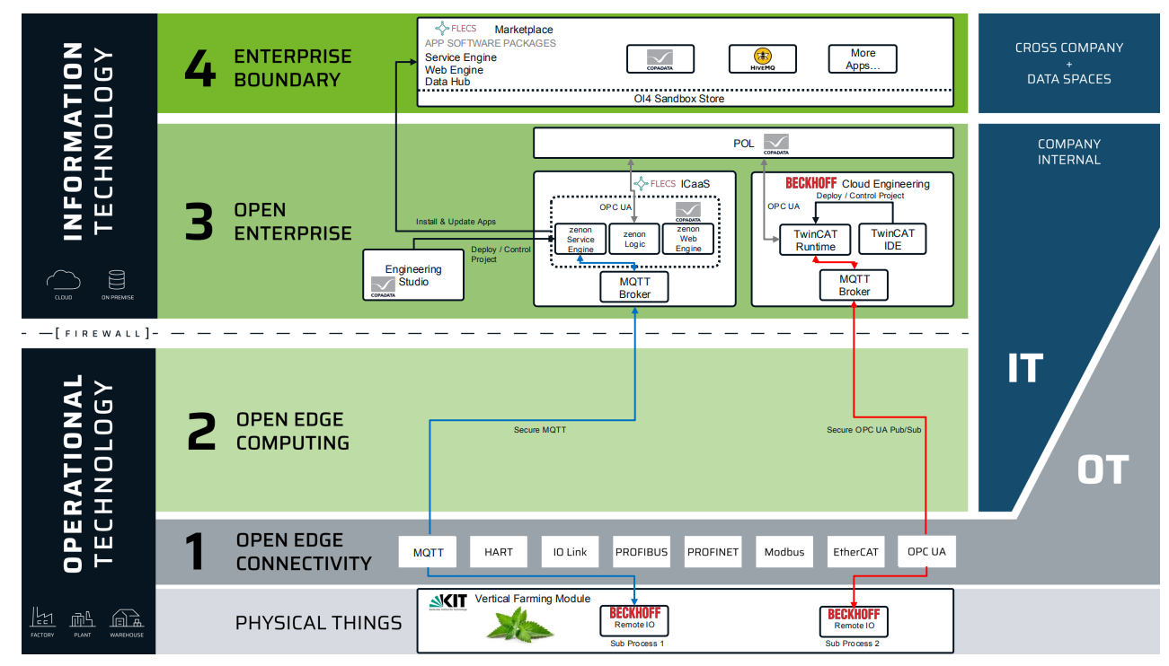
EXAMPLE – Virtual PLC and beyond: Architectural Guardrails
The technical view on used software components

Slide 8
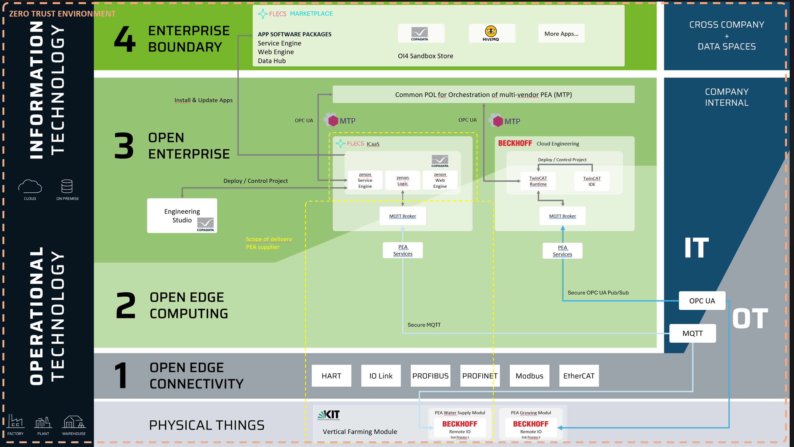
EXAMPLE – Virtual PLC and beyond (ICaaS): Architectural Guardrail

