Slide 1
The potential of AAS in the digital Production
TechCircle Battery DPP data + DPP system – JEDI Jena Digital Innovation Hub
13.02.2025 / Dr. Dirk Thieme (Volkswagen Saxony GmbH)

Slide 2
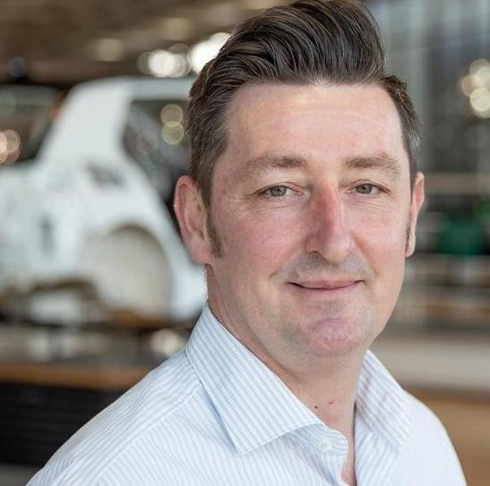
Biography Dr. Dirk Thieme
I worked at Volkswagen AG for more than 20 years. Among other things, I held responsible positions in Group IT and in Production Planning.
Since 01.04.2022 I’ve been responsible for the New Mobility & Innovation division at Volkswagen Sachsen GmbH.
The focus of my work is digitalization in production.
I’m also a founding member and board member of the Industrial Digital Twin Association e.V..

Slide 3
“The real game changer for Industry 4.0 is the use of standardized data models and IIoT.”
Dr. Dirk Thieme, Volkswagen AG

Slide 4
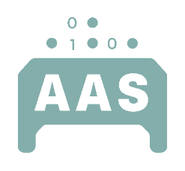
Starting Point
The common challenge
Improve productivity, efficiency and flexibility
by leveraging digital solutions
Establishment of uniform standards, consistent use of data and ensuring data security and cybersecurity
Circular economy and reduction of the CO2 footprint in production
Coordination of joint activities with the requirements of the plants and departments
Strategic Decision
VW will be using the Asset Administration Shell from the IDTA as an enabler and accelerator for the digital transformation.

Slide 5
Learnings
Digitization means the Integration of the real production environment into the digital world.
Information networking requires the usage of standard data models to share information in a uniform manner.
The main benefit of digitization is to get more transparency by using information.
The real backbone of the IIoT is a common name space, not a big data lake.

Slide 6
Expected potential of digital twin technology
1
Transformation of ongoing production with minimal interruption
2
Error prevention and time saving increase planning efficency
3
Virtual commissioning of entire halls and production facilities
4
Accelerate SOP and optimise production in progress
INTERNAL

Slide 7
1
Why we are member of IDTA?
The Asset Administration Shell is a Key-Technology for Industry 4.0
4
5
6
The AAS provides a holistic approach across the lifecycle of an asset.
2
3
The AAS opens the technology of the digital twin for the Automotive Industry.
The AAS builds the Backbone for Interoperability and the IIoT.
IDTA is an Open-Source Community, Non-Profit Organization and proofed by VW Legal.
More than 100 members are working in 6 working groups to establish this standard.

Slide 8
Current Situation
Distributed systems allow parallel work, but data synchronization is to time-consuming.
product
development
product characteristic
plant planning
process behaviour
construction
plant characteristic
data synchronization
on-site commissioning without digital twins
virtual commissioning
plant behaviour
parallel working, save time
time-consuming synchronization, loaded process quality
INTERNAL
8

Slide 9
Current Situation
Distributed systems allow parallel work, but data synchronization is to time-consuming.
product
development
product characteristic
plant planning
process behaviour
construction
plant characteristic
data synchronization
on-site commissioning without digital twins
virtual commissioning
plant behaviour
parallel working, save time
time-consuming synchronization, loaded process quality
INTERNAL
8

Slide 10
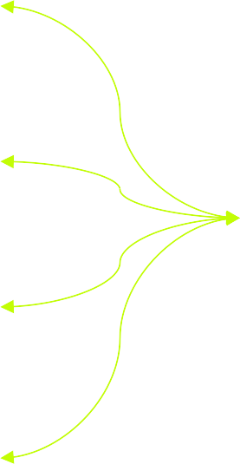
Target Picture
Intergrated digital planning by usage of true digitale twins increase flexibility and time to market.
product
development
product characteristic
Digital Twin
plant planning
process behaviour
construction
plant characteristic
real-time data synchronization
on-site commissioning and operations with true digital twins
virtual commissioning
plant behaviour
parallel working, save time
real-time data synchronization increase solution maturity
INTERNAL
9

Slide 11
The Idea of Industrial Metaverse
It‘s an virtual and interactive extansion of our real working environment.
Real World
Virtual World
Product
VR/AR
SMART
GREEN
Processes
Digital Twin
Automation
Volkswagen Industrial Metaverse
AI
Factory Planning
Edge/Cloud
Network
Industrial Internet of Things
LEAN
INTERNAL

Slide 12
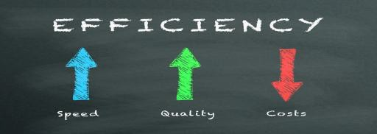
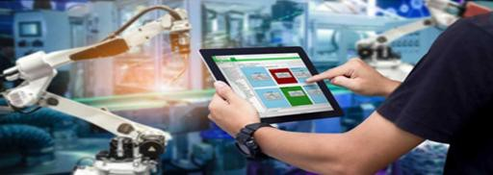
Key takeaways
Digital twins are enablers of transformation.
minimized downtime
fully integrated digital planning helps to minimize production downtime
accelerate Time to Market
AI-supported system development accelerates the solution maturity level
increase efficiency
new level of connectivity and data analytics avoids lacks as early as possible
plug and produce
reuse of a true digital twins significantly reduces the effort for commissioning
INTERNAL

Slide 13
Thank you
For more information, please contact: dirk.thieme@volkswagen.de
12

