Slide 1
Digital Product Passport (DPP) Please!
An Introduction to DPPs as required by the Ecodesign Sustainable Product Regulation (ESPR)
Adrian von Mühlenen (GPT)
PO Digital Material & Product Passport
Notes:
Adobe Stock Image 767626837 licensed

Slide 2
Don’t let yourself be Swept Away by the Regulatory Tsunami
PPWD
Recycled Content?
Reusable? Compostable?
SUP
CSRD
EPR
CSDDD
Notes:
These days, one can expect an additional regulator requirement or sustainability reporting request almost every week. Some say we are in the age of the regulatory tsunami, which is reducing the competitiveness of EU-based companies. Unfortunately, staffing up does not help as it generates more costs, and there are few technical solutions that help automate processes. Since Regulatory Compliance is the right to sell, you'd better don't mess around with AI tools either.
Image source: ChatGPT Pro prompt “Generate an image that represents the continuously growing regulatory requirements as a tsunami.”
PPWD – packaging and packaging waste directive Regulation (EU) 2025/40 https://eur-lex.europa.eu/legal-content/EN/TXT/?uri=OJ:L_202500040
SUP – Single used Plastic regulated by Directive (EU) 2019/904 on the reduction of the impact of certain plastic products on the environment https://eur-lex.europa.eu/legal-content/EN/TXT/?uri=OJ:L_202500040
EPR – Extended Producer Responsibility
CSRD – the Corporate Sustainability Reporting Directive
CSDDD – Directive on Corporate Sustainability Due Diligence

Slide 3
Green Deal – EU’s Man on the Moon Moment
| Source: https://youtu.be/F2Z7rio5sow?si=ZK8jhl6a6SvvM-Rx

Slide 4
Green Deal - EU’s Man on the Moon Moment
Transforming the EU‘s economy for a sustainable future
Increasing the EU’s Climate Ambition for 2030 and 2050
A zero-pollution ambition for a toxic-free environment
Supplying clean, affordable and secure energy
Preserving and restoring ecosystems & biodiversity
The European Green Deal
Mobilizing industry for a clean and circular economy
From Farm-to-Fork: a fair, healthy & friendly food system
Building and renovating in an energy & resource efficient way
Accelerating the shift to sustainable and smart mobility
Financing the transition
Leave no one behind
The EU as a global leader
A European climate pact
| Source: https://eur-lex.europa.eu/legal-content/EN/TXT/?uri=CELEX:52019DC0640

Slide 7
| Sources: https://www.circulaw.nl/European_green_deal.pdf https://www.europarl.europa.eu/legislative-train/theme-a-european-green-deal

Slide 8
EU Green Deal Initiatives Requiring DPPs (5 out of 168)
Battery Regulation
2023/1542
Ecodesign for Sustainable
Product Regulation
2024/1781
Construction Product
Regulation
2022/0094(COD)
Detergents Regulation
2023/0124(COD)
Toy Safety Directive
2023/0290(COD)
Circular Economy Action Plan
Fit for 55 Package
Adopted
Zero Pollution Action Plan
Farm to Fork Strategy
Under Negotiation
Biodiversity Strategy
Sustainable & Smart Mobility Strategy
| Sources: https://www.circulaw.nl/European_green_deal.pdf https://www.europarl.europa.eu/legislative-train/theme-a-european-green-deal

Slide 9
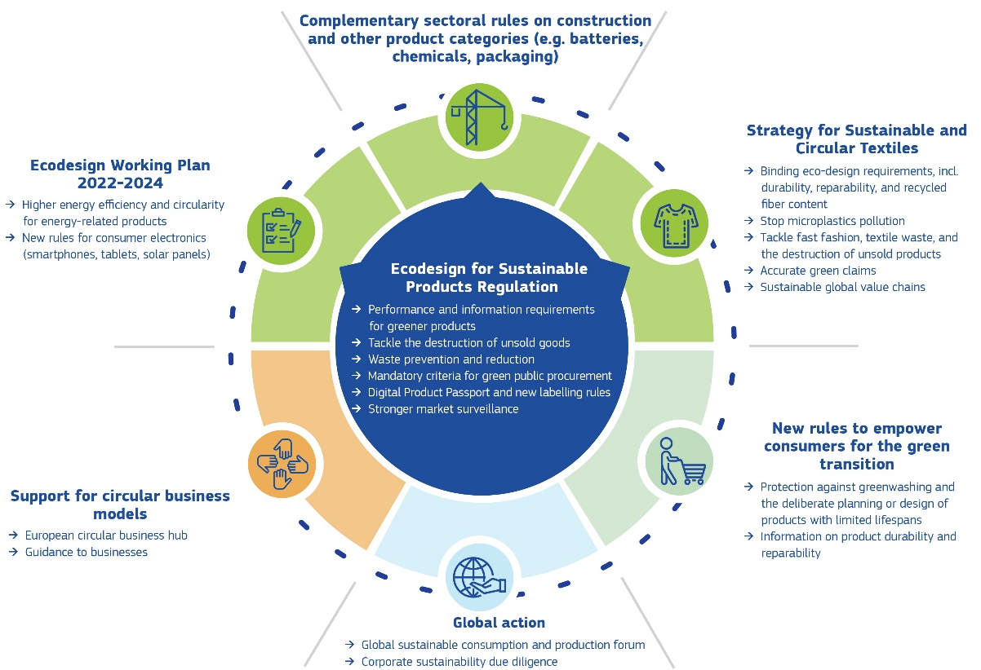
Making Sustainable Products the Norm
| Source: https://eur-lex.europa.eu/legal-content/EN/TXT/?uri=CELEX%3A52022DC0140

Slide 10
Making Sustainable Products the Norm
| Source: https://eur-lex.europa.eu/legal-content/EN/TXT/?uri=CELEX%3A52022DC0140

Slide 11
Ecodesign for Sustainable Products Regulation (ESPR)
→ Performance and information requirements for greener products
→ Tackle the destruction of unsold goods
→ Waste prevention and reduction
→ Mandatory criteria for green public procurement
→ Digital Product Passport and new labeling rules
→ Stronger market surveillance

Slide 12
Critical Aspects of the Ecodesign for Sustainable Product Regulation
Eco-design requirements (§ 5)
Performance Requirements (§ 6)
Information Requirements (§ 7)
Digital Product Passport (§ 9)
Durability, reliability, reusability, upgradability
Reparability: possibility of maintenance and refurbishment
Presence of substances of concern
Energy use or energy efficiency
Resource use or resource efficiency
Recycled content
Possibility of remanufacturing and recycling
Possibility of recovery of materials
Environmental impacts, including carbon and environmental footprint
Expected generation of waste materials
| Source: https://cirpassproject.eu/wp-content/uploads/2024/03/A2-EC-Michele-Galatola.pdf

Slide 13
Ecodesign Requirements (see ESPR §5)
Upgradeability
Water Use & Efficiency
Possibility of Re-manufacturing
Durability
Recycled Content
Presence of Substance of Concern
Recyclability
Repairability
Possibility of Maintenance & Refurbishment
Resource Use & Efficiency
Reliability
Environmental Impacts
Expected Generation of Waste
Reusability
Performance Requirements
Additional Requirements Information Requirements
Energy Use & Efficiency
Possibility of Recovery of Material
| Source: https://eur-lex.europa.eu/legal-content/EN/TXT/HTML/?uri=OJ:L_202401781#d1e2556-1-1

Slide 14
What is a Substance of Concern (SoC) (see ESPR §2.27 ff)
Regulation (EC) No 1907/2006, Article 59 → REACH, Substances of very high concern (SVHCs)
Annex VI to Regulation (EC) No 1272/2008 → Classification and Labelling (CLP) Regulation
Regulation (EU) 2019/1021, Persistent Organic Pollutants (POPs) legislation
Negatively affects the reuse and recycling of materials in the product in which it is present.
carcinogenicity categories 1 and 2
germ cell mutagenicity categories 1 and 2
reproductive toxicity categories 1 and 2
endocrine disruption for human health categories 1 and 2
endocrine disruption for the environment categories 1 and 2
persistent, mobile and toxic or very persistent, very mobile properties
persistent, bioaccumulative and toxic or very persistent, very bioaccumulative properties
respiratory sensitisation category 1
skin sensitisation category 1
hazardous to the aquatic environment — categories chronic 1 to 4
hazardous to the ozone layer
specific target organ toxicity — repeated exposure categories 1 and 2
specific target organ toxicity — single exposure categories 1 and 2
| Source: https://eur-lex.europa.eu/legal-content/EN/TXT/HTML/?uri=OJ:L_202401781#d1e1581-1-1

Slide 15
What Shall Not Be Covered by the Ecodesign for Sustainable Product Regulation (ESPR)?
Article 1, Paragraph 2
This (Ecodesign for sustainable Product) Regulation applies to any physical goods that are placed on the market or put into service, including components and intermediate products. However, it does not apply to:
Food
Feed
Medicinal products for human use
Veterinary medicinal products
Living plants, animals and micro-organisms
Products of human origin
Products of plants and animals relating directly to their future reproduction
Vehicles
Regulation (EC) 178/2002
Regulation (EC) 178/2002
Regulation (EU) 167/2012, Regulation (EU) 168/2023, Regulation (EU) 2018/858
Directive 2001/83/EC
Regulation (EU) 2019/6
| Source: https://eur-lex.europa.eu/legal-content/EN/TXT/HTML/?uri=OJ:L_202401781#d1e1513-1-1

Slide 16
What Shall Be Covered by the Ecodesign for Sustainable Product Regulation (ESPR)?
Article 1, Paragraph 2
This (Ecodesign for sustainable Product) Regulation applies to any physical goods that are placed on the market or put into service, including components and intermediate products.
End-use Products
Intermediate Products
Textile
Furniture
Mattresses
Construction
Tires
Detergents
ICT
Steel
Non-Ferrous Metals
Aluminum
Chemicals
Lubricants
Ceramics
Paints
Cosmetics
Toys
Fishing Nets & Gear
Absorbent Hygiene Products
Energy Related Products
Plastic and Polymers
Paper Pulp and Boards
Glass
| Source: https://publications.jrc.ec.europa.eu/repository/handle/JRC138903

Slide 17
What Shall Be Covered by the Ecodesign for Sustainable Product Regulation (ESPR)?
Article 18, Paragraph 5
In the first working plan, which shall be adopted by 19 April 2025, the Commission shall prioritise the following product groups.
End-use Products
Intermediate Products
Textile
Furniture
Mattresses
Construction
Tires
Detergents
ICT
Steel
Aluminum
Chemicals
Lubricants
Paints
Toys
Energy Related Products
| Source: https://eur-lex.europa.eu/legal-content/EN/TXT/HTML/?uri=OJ:L_202401781#art_18

Slide 18
Why is a Digital Product Passport (DPP) Required
The Ecodesign for Sustainable Product Regulation (ESPR) requires the introduction of digital product passports (DPPs)
§1.1: “This Regulation also establishes a digital product passport, provides for the setting of mandatory green public procurement requirements and creates a framework to prevent unsold consumer products from being destroyed.” and
§1.2: “This Regulation applies to any physical goods that are placed on the market or put into service, including components and intermediate products.”
ESPR §4 empowers the commission to adopt delegated acts (… that) shall include at least the elements listed in §8.
ESPR §8 requires that products may only be placed on the market or put into service if a digital product passport (‘product passport’) is available in accordance with delegated acts to be adopted under the future Regulation.
| Source: https://eur-lex.europa.eu/legal-content/EN/TXT/?uri=CELEX:52019DC0640

Slide 19
What is the Digital Product Passport (DPP)? (see ESPR §9 - §15)
ID
Third-Party (optional)
Unique Identifier for products, companies, etc. and their verification
ID
Validation
ID
Access rights management and control mechanism
Link to product
Product
Compliance
Product
Compliance
(Decentral) data storage, data persistence
Product
Compliance
Product
Compliance
Data processing, data exchange protocols
Digital
Product
Passport
Data Access Right Mgmt
ID
ID
Product
Information
Semantic standards for product information, syntactic standards for data formats
Product
Information
Product
Information
Validation
Validation
Validation
Data authentication, reliability, integrity, security, and privacy
Issues
ID
ID
Tier n
Value chain actor
Economic Operator
Tier 1
Tier n
Source:

Slide 20
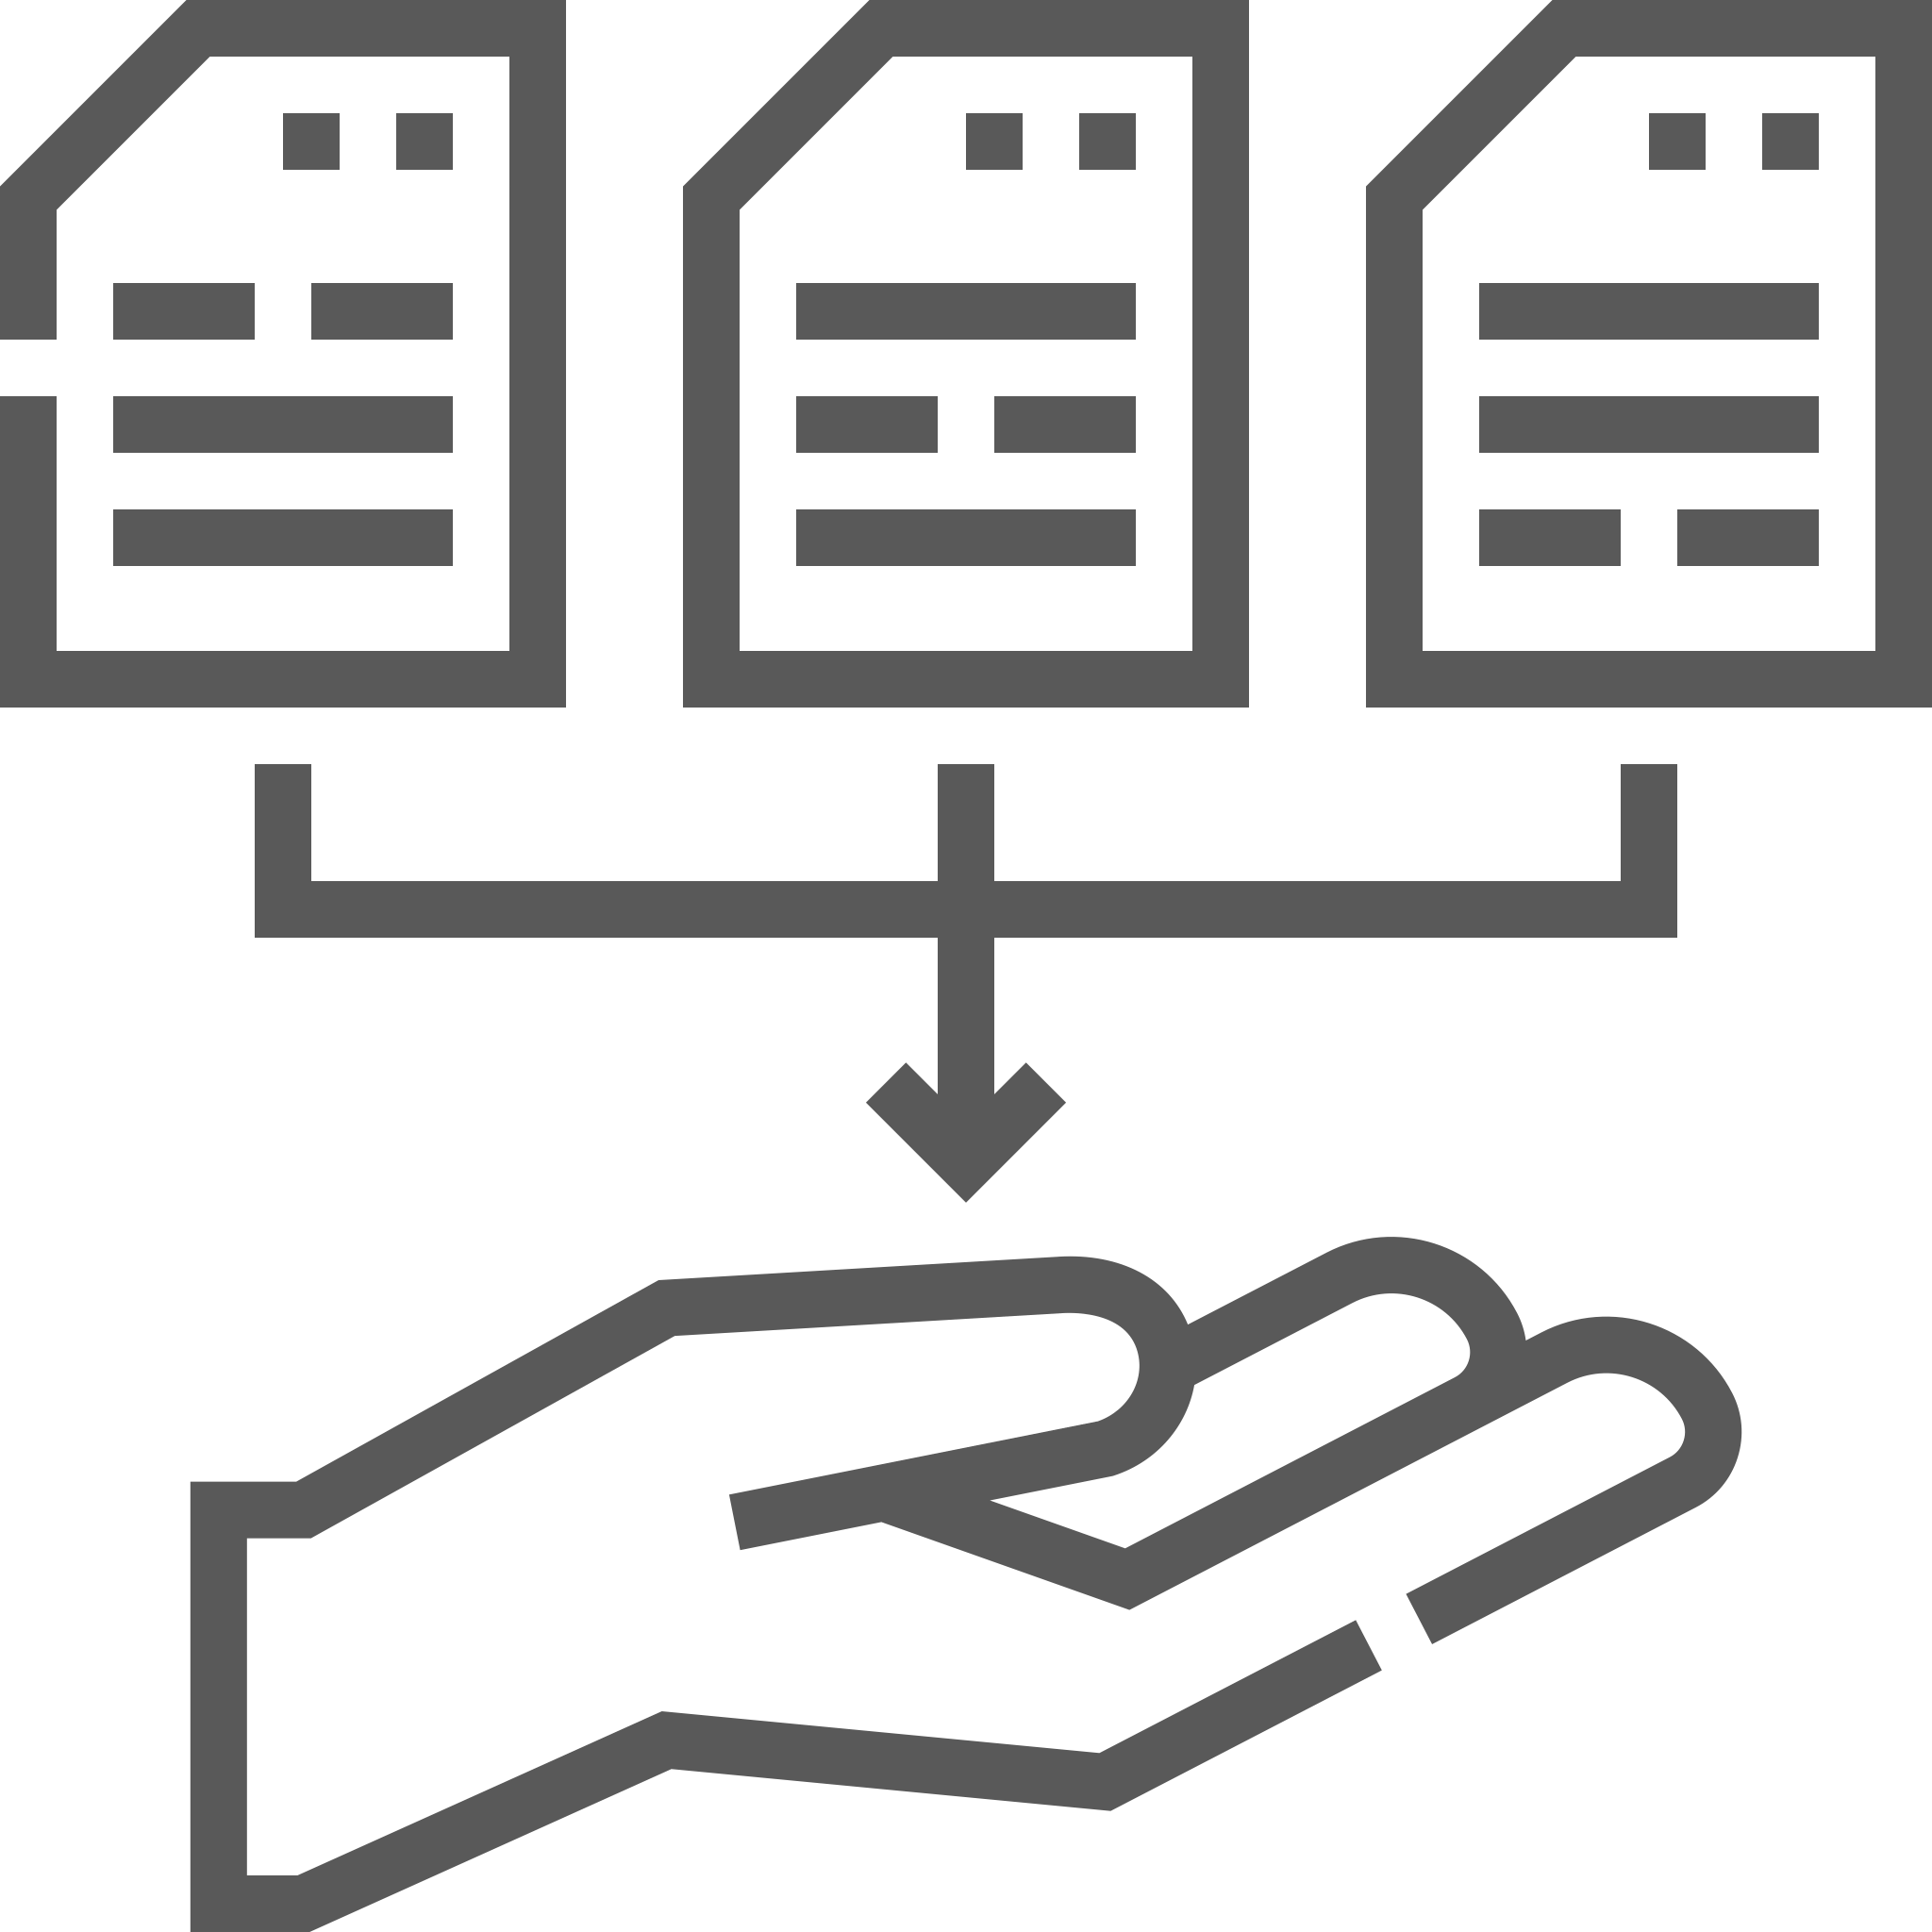
What is the Digital Product Passport (DPP)? (see ESPR §9 - §15)
DPP System
DPP Data
Standardization Request (SREQ)
Unique Identifier
Data Carrier
Look-up Mechanism
Access Rights Management
DPP Web Portal
Delegated Act
Interoperability
Data Storage & Persistence
Data Authentication, Reliability, Integrity
Data Security & Privacy
DPP Registry
Ecodesign Specifications
Product Groups
Source: https://ec.europa.eu/growth/tools-databases/enorm/mandate/604_en

Slide 21
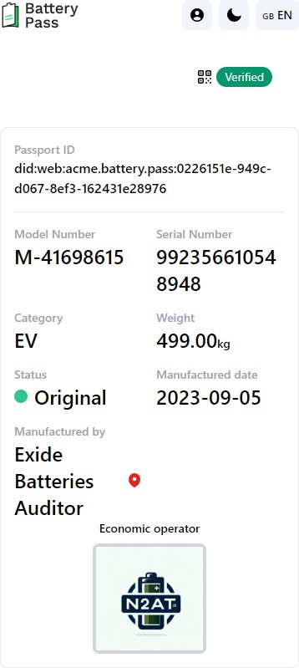
DPP Vision / Battery Passport
| Source: https://thebatterypass.eu

Slide 22
Lessons Learned from the Battery Pass
BATTERY PASS
Nº- SZ41621956
Battery Passport Systems
Economic operators’ back-end systems
Data Collection
Miner
Refiner
Precursor and CAM producer
Cells and modules manufacturer
Pack producer
OEM
End-user
Reuser
Remanufacturer
Repurposer
Collector
Dismantler
Recycler
This project receives funding from the German Federal Ministry for Economic Affairs and Climate Action by resolution of the German Bundestag under grant agreement No 16BZF335.
| Source: https://thebatterypass.eu

Slide 23
Lessons Learned from the Battery Pass
BATTERY PASS
Nº- SZ41621956
Battery Passport Systems
Economic operators’ back-end systems
Direct reporting for aggregation in economic operator’s back-end system(s)
Data Exchange
Optional supportive systems (e.g., traceability systems, IMDS)
Data Collection
Miner
Refiner
Precursor and CAM producer
Cells and modules manufacturer
Pack producer
OEM
End-user
Reuser
Remanufacturer
Repurposer
Collector
Dismantler
Recycler
This project receives funding from the German Federal Ministry for Economic Affairs and Climate Action by resolution of the German Bundestag under grant agreement No 16BZF335.
| Source: https://thebatterypass.eu

Slide 24
Lessons Learned from the Battery Pass
BATTERY PASS
Nº- SZ41621956
Battery Passport Systems
Economic operators’ back-end systems
Data Processing
Direct reporting for aggregation in economic operator’s back-end system(s)
Data Exchange
Optional supportive systems (e.g., traceability systems, IMDS)
Data Collection
Miner
Refiner
Precursor and CAM producer
Cells and modules manufacturer
Pack producer
OEM
End-user
Reuser
Remanufacturer
Repurposer
Collector
Dismantler
Recycler
This project receives funding from the German Federal Ministry for Economic Affairs and Climate Action by resolution of the German Bundestag under grant agreement No 16BZF335.
| Source: https://thebatterypass.eu

Slide 25
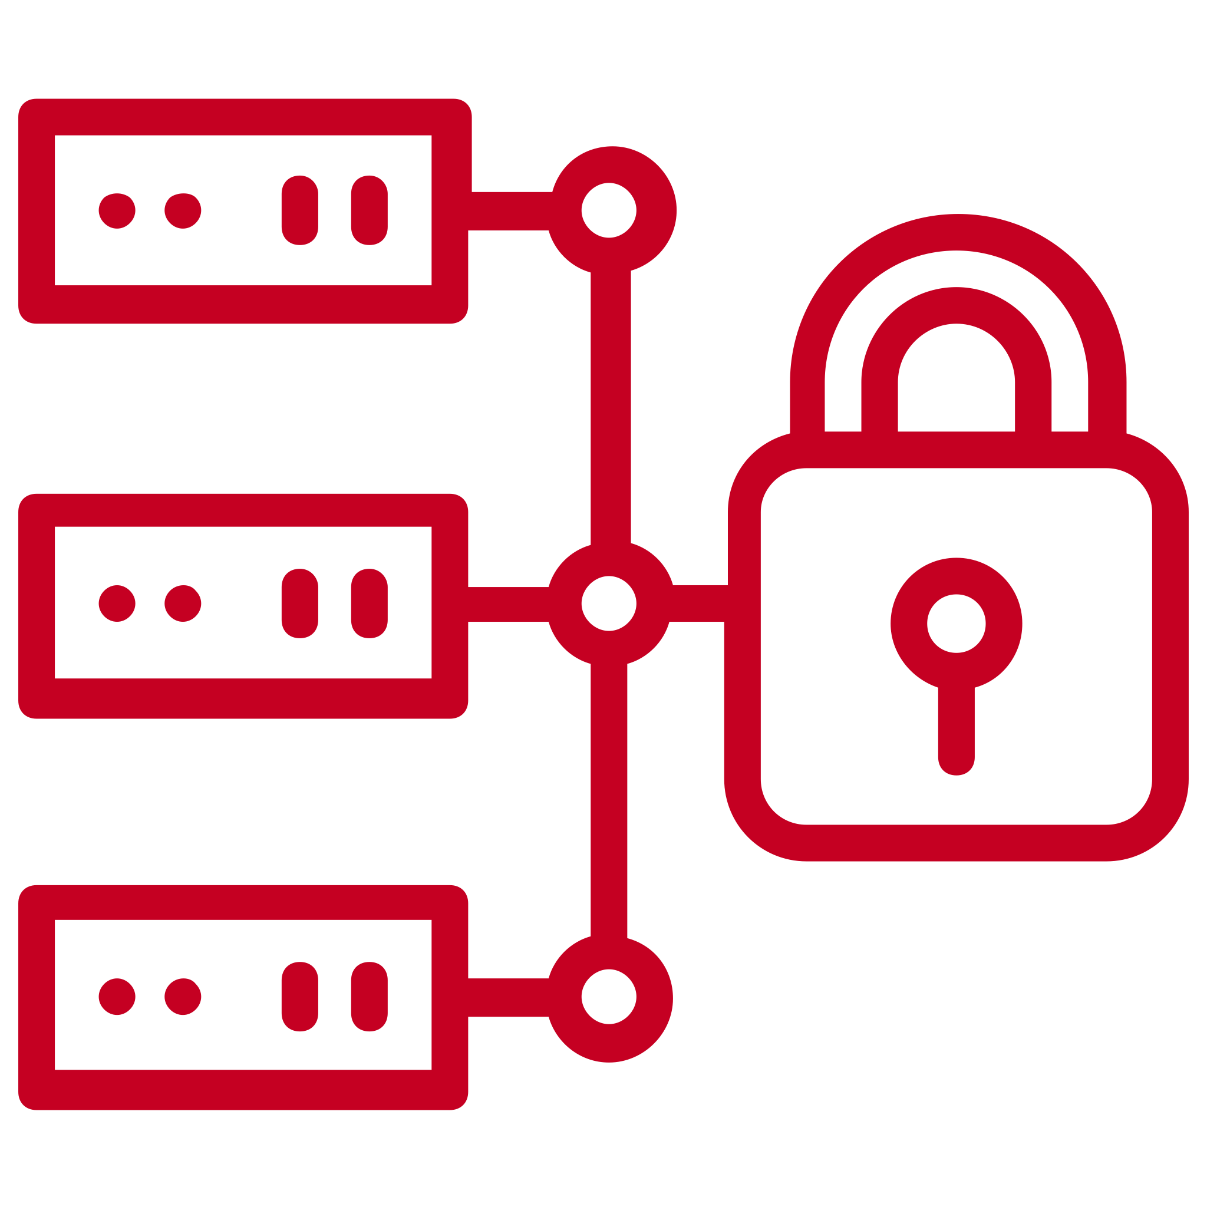
Lessons Learned from the Battery Pass
BATTERY PASS
Nº- SZ41621956
Data Access
Battery Passport Systems
Product Passport Registry
Economic operators’ back-end systems
Data Processing
Direct reporting for aggregation in economic operator’s back-end system(s)
Data Exchange
Optional supportive systems (e.g., traceability systems, IMDS)
Data Collection
Miner
Refiner
Precursor and CAM producer
Cells and modules manufacturer
Pack producer
OEM
End-user
Reuser
Remanufacturer
Repurposer
Collector
Dismantler
Recycler
This project receives funding from the German Federal Ministry for Economic Affairs and Climate Action by resolution of the German Bundestag under grant agreement No 16BZF335.
| Source: https://thebatterypass.eu

Slide 26
Lessons Learned from the Battery Pass
Data Access
Lifecycle Management, Roles & Responsibilities
Data Processing
Audit, Rulesets, Standards
Data Exchange
Interoperability (“What”, “How”)
Data Collection
Availability, Automation, Harmonization, Sovereignty, Validation
| Source: https://thebatterypass.eu

Slide 27
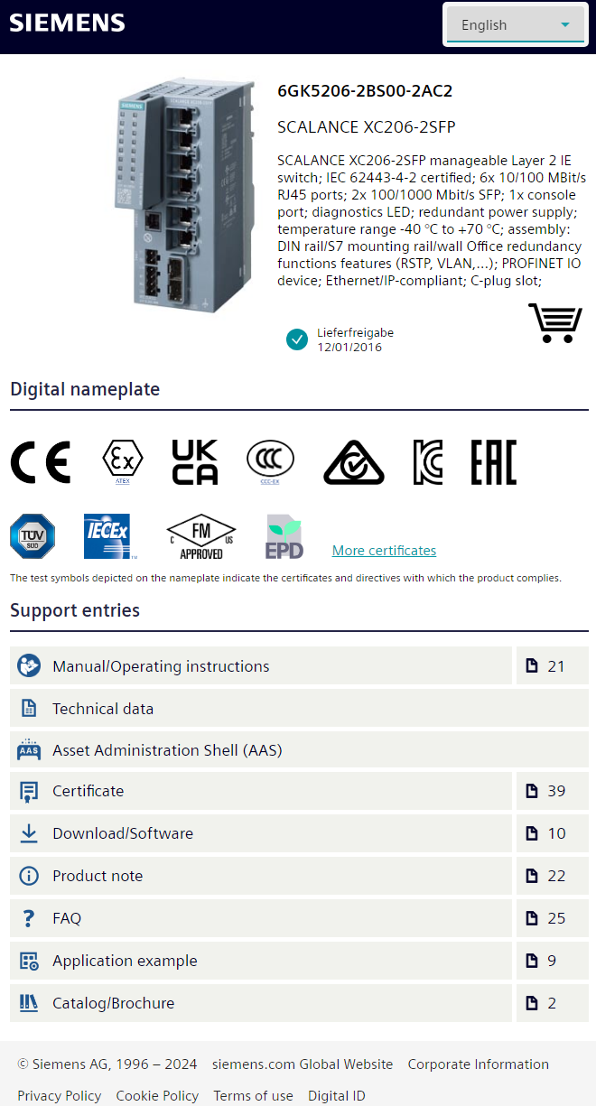
DPP-Reality In the Process Industry. ID Link
| Source: https://www.digitaldatachain.com

Slide 28
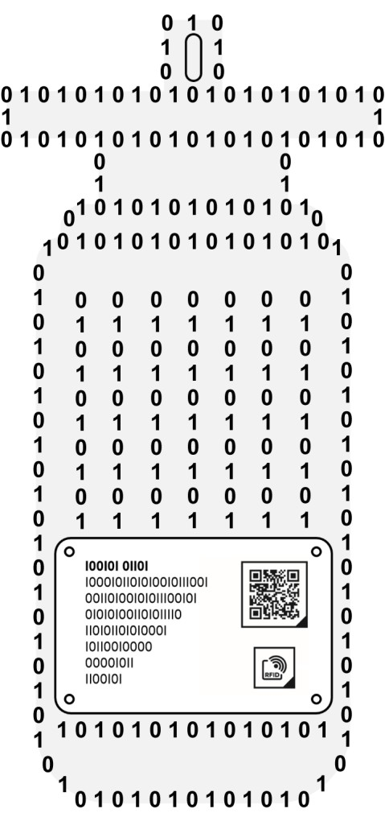
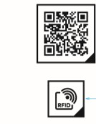
DPP-Reality In the Process Industry. ID Link
physical object
digital twin
digital representation of the physical object
Information model
tech specs
documentation
life cycle information
…
Advantages ID link
URL based
100% cost-free
100% interoperable
From / for the industry
Name Plate
AAAAAAAAAAAAAAA BBBBBBBBBBBBB
CCCCCCCCCC
DDDDDDDD
EEEEEEE FFFFFF GGG
| Source: https://www.digitaldatachain.com

Slide 29
Catena-X Architecture to Power Sovereign Data Exchange for DPP
Open Source SaaS
GreenToken SaaS licensed to
SiGreen SaaS licensed to
Tenant
Tenant
Tenant
Tenant Tenant
Tenant
Tenant Tenant
SME 1
SME 1
EDC
EDC
Data Exchange Option B
EDC
CSV-Upload
my fully-managed Catena-X cloud stack
with my
Catena-X
Federated Operating Environment
EDC
No operational data
Portal
Digital Twin
Registry
Semantic
Hub
No operational data
IoT
Adapter
Identity
Provider
Marketplace
Contracting / …
…
my Catena-X cloud stack with my
EDC
Marketplace Navig., Apps, Services
Authentication
DAPS → Cust. Wallet
Self-Description Hub
No operational data
No operational data
SME 2
Digital Twins
EDC
EDC
Digital Twins
IAM
IAM
…
Data Exchange Option A
…
| Source: https://catena-x.net/en/1/offers/edc-the-central-component

Slide 30
Mind the Product Lifecycle and the Involved Data
Assemble
Use, Re-use, Repair
Collect & Dismantle
Manufacture
Recycle
Do you know your supply chain actors who can access the DPP data?
Right granularity (model, batch, item)?
DPP-Data available?
Backup of the DPPs done?
Market surveillance mechanisms?
Source
Refine
DPP
Digital Twin
Life Cycle Management
Substances of Concern
Sustainability & Circularity
DPP
Digital Twin
Life Cycle Management
Substances of Concern
Sustainablity & Circularity

Slide 31
Timeline
Dec '23
Trilogue
compromise
July '24
Entry into force
18.07.2024
April '25
First ESPR working plan
Dec ‘25
Standards CEN/CLC DPP-System
2027
Enforcement of first DA's for product groups
Legislative
procedure
Apr/May '24
Parliament approval Council approval
Dec '24
First meeting of Ecodesing Forum
2025
Adoption of first delegated acts for product groups
Mar '22
COM proposal
Preparatory studies and stakeholder surveys

Slide 32
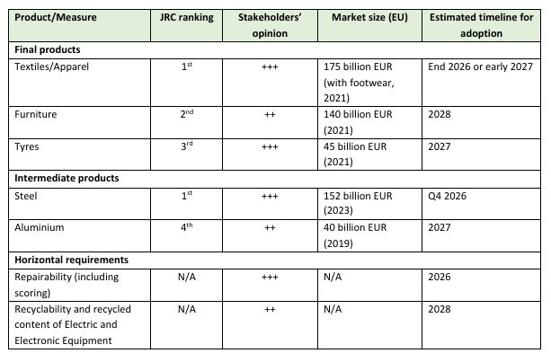
First Draft of the ESPR Work Plan 2025-2030 Proposes a shortened List of Products to Cover
Chemicals: The Commission suggests conducting a study during the implementation of the first ESPR Working Plan. This study shall define precisely the potential scope of one or several measures for consideration in a subsequent working plan.
Polymers: Not mentioned in the draft document
The work plan is to be adopted by 19.4.2025. Once adopted, it will be up for review after 3 years
| Source: https://ec.europa.eu/transparency/expert-groups-register/core/api/front/document/113700/download

Slide 33
Timeline con’t
Multiannual Work Plans
Preparatory Study & Impact Assessment
~ 1st WP Q1/25
1,5 – 2 years
Consultation of Ecodesign Forum
Adoption of Measure
Adoption first measures 2026
Applicable after 18 months 2027/28
Measures applies
| Source: https://commission.europa.eu/document/download/c5db3b9e-23ae-42c8-a50a-b549f20a377d_en?filename=2024_05_22_EC%20Presentation%20ESPR%20Webinar_final.pdf

Slide 34
Wrap-up & Checklist
Is there a viable Business Case?
Are you an Economic Operator?
Are your products falling under the ESPR?
Is your product part of a prioritized product groups?
Are you aware of the data required to report on the Ecodesign Requirements?
Are you aware of the product categories' priorities and timelines?
Do you possess the relevant information, performance, and additional requirements?
Is your MDM / PIM ready to host the DPP-Data?
Do you know the downstream actors and their R&Rs along the product lifecycle?
Are you aware of the market surveillance mechanism?
Can you issue a unique identifier for the granularity required?
Can you back up DPPs?
Is there a viable Business Case?

Slide 35
Don’t let yourself be Swept Away by the Regulatory Tsunami
PPWD
Recycled Content?
Reusable? Compostable?
SUP
CSRD
EPR
CSDDD
Notes:
These days, one can expect an additional regulator requirement or sustainability reporting request almost every week. Some say we are in the age of the regulatory tsunami, which is reducing the competitiveness of EU-based companies. Unfortunately, staffing up does not help as it generates more costs, and there are few technical solutions that help automate processes. Since Regulatory Compliance is the right to sell, you'd better don't mess around with AI tools either.
Image source: ChatGPT Pro prompt “Generate an image that represents the continuously growing regulatory requirements as a tsunami.”
PPWD – packaging and packaging waste directive Regulation (EU) 2025/40 https://eur-lex.europa.eu/legal-content/EN/TXT/?uri=OJ:L_202500040
SUP – Single used Plastic regulated by Directive (EU) 2019/904 on the reduction of the impact of certain plastic products on the environment https://eur-lex.europa.eu/legal-content/EN/TXT/?uri=OJ:L_202500040
EPR – Extended Producer Responsibility
CSRD – the Corporate Sustainability Reporting Directive
CSDDD – Directive on Corporate Sustainability Due Diligence

Slide 36
Stabilize your Core Processes – Use Standards, Harmonize Data Exchange and Foster Transparency. Act Now!
Notes:
Image Source: Shutterstock 1586731783
Efficiency increases as soon as the core processes get stable and the communication and data exchange follow existing standards for harmonized data (e.g., vocabularies) and implementing and following policies to foster transparency along the supply chain.

Slide 37
Take Home Messages
Horizontal DPPs are key
Standards for technical implementation
Standards for Interoperability (”what” & “how”)
Standards for assessment algorithms (e.g. PCF)
Data Sovereignty is key
Decentralized DPP Data Storage
Chem-X addresses these key requirements
Launch & Press Release in January 2025

Slide 38
References in the Sequence of Appearance
EU Green Deal – EU’s Man on the Moon Moment - https://youtu.be/F2Z7rio5sow?si=ZK8jhl6a6SvvM-Rx
EU Green Deal – https://eur-lex.europa.eu/legal-content/EN/TXT/?uri=CELEX:52019DC0640
EU Green Deal overview – https://www.circulaw.nl/European_green_deal.pdf
Batteries and waste batteries regulation, (EU) 2023/1524 – https://eur-lex.europa.eu/eli/reg/2023/1542/oj
Ecodesign for Sustainable Product Regulation (ESPR), (EU) 2024/1781 – https://eur-lex.europa.eu/legal-content/EN/TXT/?uri=CELEX:32024R1781
Proposal for Construction Product Regulation (CPR), 2022/0094(COD) – https://eur-lex.europa.eu/legal-content/EN/TXT/?uri=celex:52022PC0144
Proposal for Detergents and Surfactants Regulation, 2023/0124(COD) – https://eur-lex.europa.eu/legal-content/en/TXT/?uri=COM:2023:217:FIN
Proposal for Toys Safety Regulation, 2023/0290(COD) – https://eur-lex.europa.eu/legal-content/EN/TXT/?uri=celex:52023PC0462
EU Green Deal Legislative Train Schedule – https://www.europarl.europa.eu/legislative-train/theme-a-european-green-deal
Make sustainable Products the norm – https://eur-lex.europa.eu/legal-content/EN/TXT/?uri=CELEX:52022DC0140
Ecodesign for Sustainable Product Regulation (ESPR) – https://eur-lex.europa.eu/legal-content/EN/TXT/?uri=CELEX:32024R1781
JRC Preliminary Study on New Product Priorities (Draft) – https://susproc.jrc.ec.europa.eu/product-bureau/sites/default/files/2023-01/Preliminary%20ESPR%20WP%20Report_MERGED_CLEAN_.pdf
JRC Preliminary Study on New Product Priorities - https://publications.jrc.ec.europa.eu/repository/handle/JRC138903
Critical Aspects of the DPP – https://cirpassproject.eu/wp-content/uploads/2024/03/A2-EC-Michele-Galatola.pdf
ESPR EU COM Homepage – https://commission.europa.eu/energy-climate-change-environment/standards-tools-and-labels/products-labelling-rules-and-requirements/ecodesign-sustainable-products-regulation_en
DPP System Standardization Request (SREQ) – https://ec.europa.eu/growth/tools-databases/enorm/mandate/604_en
The Battery Pass project – https://thebatterypass.eu
Digital Data Chain Consortium Identity Link – https://www.digitaldatachain.com
Catena-X Architecture and Offering – https://catena-x.net/en/1/offers/edc-the-central-component
ESPR updated working plan – https://ec.europa.eu/transparency/expert-groups-register/core/api/front/document/113700/download
ESPR Timeline and next steps – https://commission.europa.eu/document/download/c5db3b9e-23ae-42c8-a50a-b549f20a377d_en?filename=2024_05_22_EC%20Presentation%20ESPR%20Webinar_final.pdf

Slide 40
Thank you!
Questions? Comments? Please connect with me
/in/adrian-von-muehlenen
Book an appointment
adrian.von-muehlenen@basf-intertrade.com
+49 172 86 99 530

