Slide 1


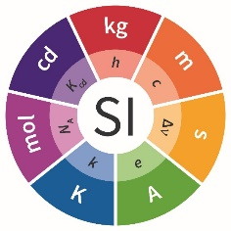

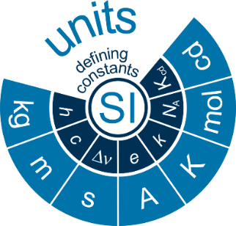
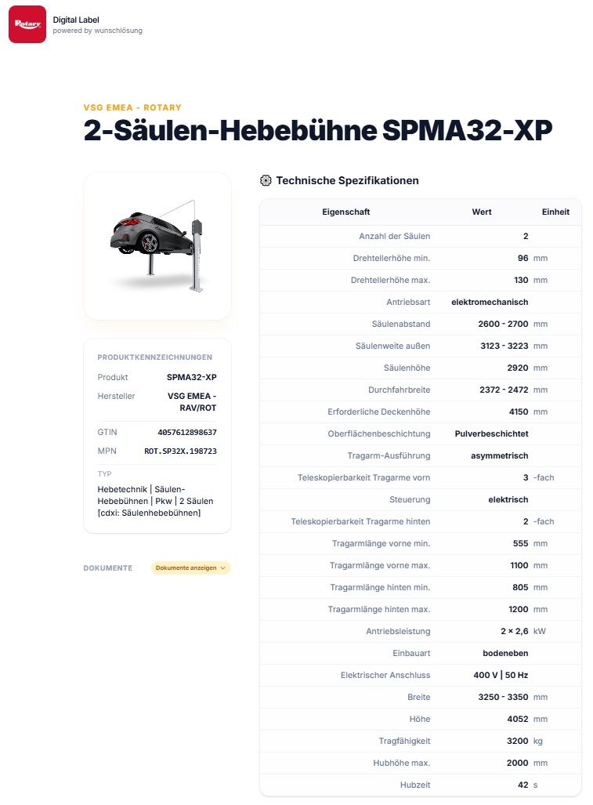
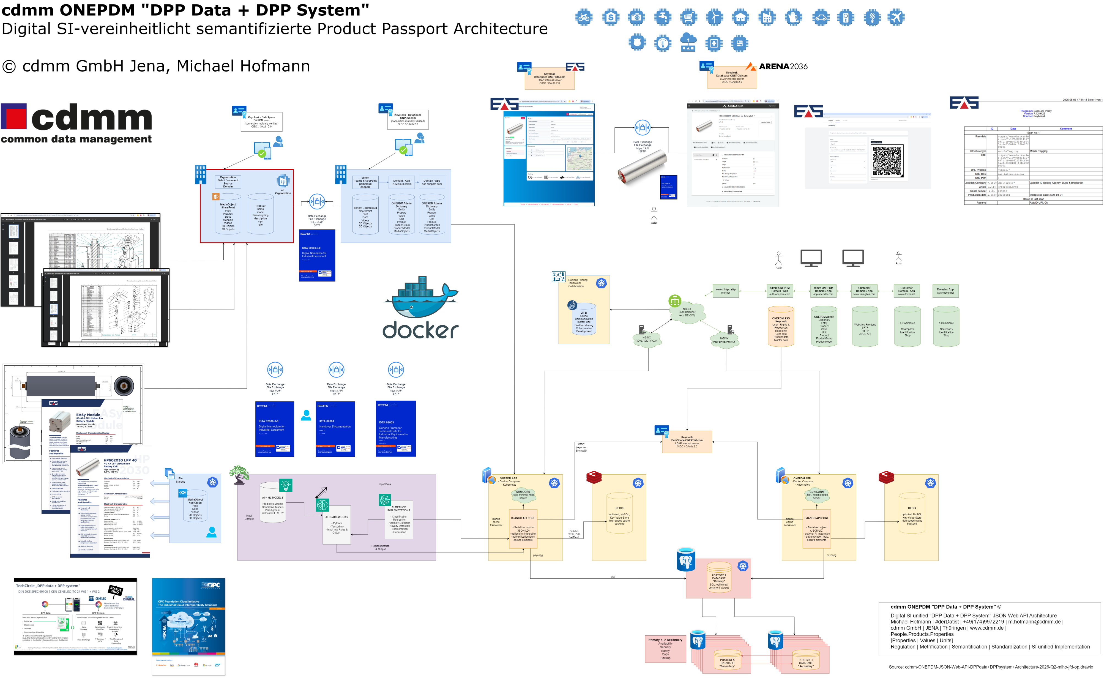

cdmm ONEPDM
DPP Open Source Implementation
Short description:
“Every product will have its own website!”​
MLP (Minimum Lovable Product) of fully scalable Showcase-Implementation (UHP Ultra Hight Performance DPP via API)​
Ready to integrate with real unified product data sources​
Developed by an interdisciplinary consortium with end-to-end expertise (regulation, metrification, standardization, integration & innovation?
API & User-centered design, containerized platform technology, open marketing & sales
Benefit from DPP cross-industries best practices​ (OEM & IAM)
DPP as a springboard, rather than only meeting regulatory requirements (New customer Touchpoint incl. potential for up- and cross-selling products as well as extended services​)
Focus on core business technologies, real scalable Digital SI semantified “DPP Data + DPP System” architectures, instead of developing an own solution​ without Nature Constants
DPP OS Preview: cdmm ONEPDM Open Source Architecture
DPP Example: DI Data Identifier Product.gtin ?.8P https://dpp.wunschloesung.com/product/onepdm/?.8P=4057612898637
Contact: Michael Hofmann | cdmm GmbH | JENA | Thuringia https://www.linkedin.com/in/michael-hofmann-cdmm
for more information, please visit the full cdmm slide deck
click
click
Example: dpp.wunschloesung.com

Slide 2
#ONEPDM | ONEDPP Open Source Implementation
Vertical/industry & target groups:
Purpose & problem addressed:
for all Industries, for all Sectors, for all Languages
for all Products (ISO IEC 15459 Digital Object Link ready)
for all ProductGroups (ESPR Annex III & “Attribute Longlist” ready)
Digital SI unified.
- No.1 “DPP Data + DPP System” concept with New SI System (2019) inside
- No.1 Vocabulary concept inside – Digital SI, Schema.org, IEC CDD, etc.
- No.1 Long-life DPP Product Data Model
- Cross-sectors ISO IEC 15459 DI Data Identifier inside (GS1 & ANSI MH10)
- Long-life interoperability & updateability concept inside
Core functionality & key components :
Covered DPP components (e.g. data model, backend, interfaces):
- SI System Core inside (The New BIPM SI System of Units)
- Multi Vocabulary Concept inside (IEC CDD, ECLASS, GS1, UNTP, etc.)
- SI unified Semantics Concept inside - for all Times, for all People, for all DPP (EDI, EDIFACT, AIM, ANSI, IDTA, OPC-UA etc.)
- ONEPDM DPP Product Data Model (Properties|Values|Units)
- Keycloak Access Control (LDAP, OIDC, OAuth2.0, SSO)
- Django Web API Core (Python, CRUD)
- GUNICORN Web Server (fast, minimal, https)
- Primary + Secondary Postgres Databases / Redis Cache
- XML, JSON, JSON-LD serialization inside (ISO IEC 15459 ready)
License models:
Development stage (concept, prototype, production-ready):
- End User Model (Saas, in Development, Call to Action ;-)
- Sales Partner Model (in Development, Call to Action ;-)
- Technology & Investment Partner Model (Call to Action ;-)
Backend Django Web API, ready
PDM Product Data Model, ready
DPP Data Model, in development (EU Commission, Deleg. Acts, Registry)
DPP unified Frontend, in development
Existing use cases:
Pilots:
Manufacturer Product Catalogues, Pricelists, Spare Parts Systems
Retailer Product Catalogues, Pricelists, Spare Parts Systems
Service Partner, Spare Parts, R&M Repair & Maintenance Systems
DPP transformation in Progress – Example: Ravaglioli
DPP transformation in Progress – Example: Rotary
XML https://dpp.onepdm.com/v1/product/?mpn=ROT.SP35X.199263&format=xml
JSON https://dpp.onepdm.com/v1/product/?mpn=ROT.SP35X.199263&format=json
JSON-LD, in development

